Slide 1
Stoic and Emotional Perspectives in Decision-Making
H. Richard Priesmeyer
Bill Greehey School of Business
St. Mary’s University
San Antonio, Texas
Academy of Business Research, November, 2012

Slide 2
Stoic and Emotional Perspectives in Decision Making
How do Emotions influence decision making?
Stoic
Reason
Logic
Emotional
Surprise
Fear
Anger

Slide 3
Stoic and Emotional Perspectives in Decision Making
The Stoic Perspective
The words of Zeno, Chrysippus, Aristotle, Epictetus and Seneca can be taken as advice- long neglected- as to how emotions should influence decision-making.
According to Russo (2000), “When the ancient Stoa speak of the passions; they:
(1) Connect them with judgment and beliefs,
(2) imply that these judgments are, by their very nature, incorrect,
(3) are contrary to reason and the cause of faulty judgments,
(4) believe that all passions are an impediment to virtue.”

Slide 4
Stoic and Emotional Perspectives in Decision Making
The Stoic Perspective
What the stoics advocated was a rational-cognitive approach to decision-making.
What we practice in business today is decision-making laden with unacknowledged emotional influences.

Slide 5
Stoic and Emotional Perspectives in Decision Making
The Influence of Emotions
Consumer
Cognitions
Advertising
Stimulus
Purchase
Intent
Consumer
Emotions
Morris, J.D., C. Woo, J.A. Geason & J. Kim (2002). The Power of Affect, Journal of Advertising Research, June, 7-17.

Slide 6
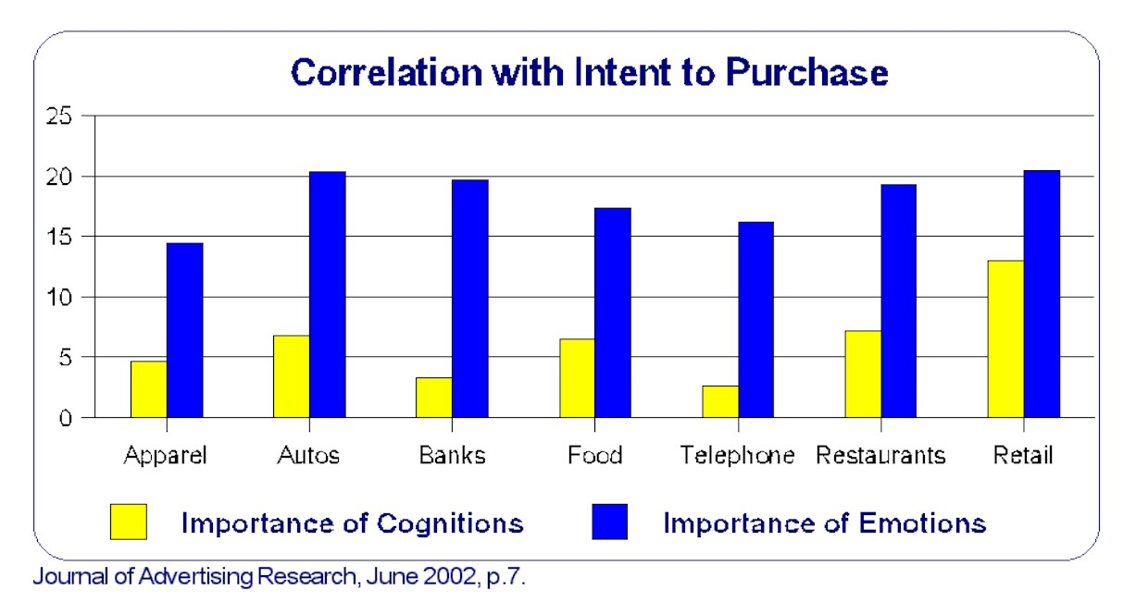
Stoic and Emotional Perspectives in Decision Making
The Influence of Emotions

Slide 7
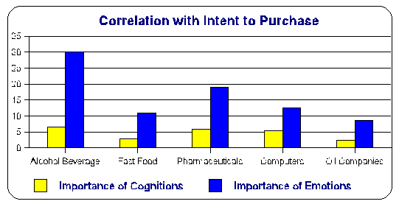
Stoic and Emotional Perspectives in Decision Making
The Influence of Emotions

Slide 8
Stoic and Emotional Perspectives in Decision Making
The Influence of Emotions
Consumer
Cognitions
33% Cognitions
Advertising
Stimulus
Purchase
Intent
Consumer
Emotions
66% Emotions

Slide 9
Stoic and Emotional Perspectives in Decision Making
Measuring emotions
The experiment
Hypotheses
Results
Discussion

Slide 10
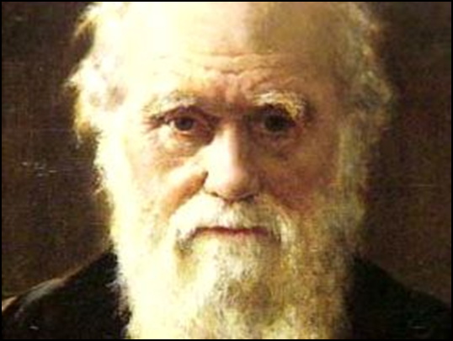
Stoic and Emotional Perspectives in Decision Making
Measuring emotions
The literature provides strong support for 11 basic emotions
A major first-contributor to the literature was Charles C. Darwin’s book “The Expression of Emotions in Man and Animals” in 1872.

Slide 11
Stoic and Emotional Perspectives in Decision Making
Measuring emotions
THEORIST | YEAR | EMOTIONS
Bell | 1806 | Joy, wonder, astonishment, rage
Darwin | 1897 | Joy, surprise/astonishment, disgust, contempt, anger
McDougall | 1921 | Fear, disgust, wonder, anger, subjection, elation, tenderness
Jorgensen | 1928 | Fear, happiness, sorrow, want, anger, shyness
Cattell | 1957 | Sex-lust, fear, loneliness, pity, curiosity, pride, sensuous, comfort, despair, sleepiness, anger
Tompkins | 1962 | Interest, joy, surprise, sadness, anger, disgust, contempt, fear, shyness/shame
Izard | 1972 | Interest, joy, surprise, sadness, anger, disgust, contempt, fear, shyness, shame
Shalif | 1999 | Happiness, interest, surprise, disgust, contempt, anger, fear, shame, distress, sadness

Slide 12
Stoic and Emotional Perspectives in Decision Making
Measuring emotions
THEORIST | YEAR | EMOTIONS
Bell | 1806 | Joy, wonder, astonishment, rage
Darwin | 1897 | Joy, surprise/astonishment, disgust, contempt, anger
McDougall | 1921 | Fear, disgust, wonder, anger, subjection, elation, tenderness
Jorgensen | 1928 | Fear, happiness, sorrow, want, anger, shyness
Cattell | 1957 | Sex-lust, fear, loneliness, pity, curiosity, pride, sensuous, comfort, despair, sleepiness, anger
Tompkins | 1962 | Interest, joy, surprise, sadness, anger, disgust, contempt, fear, shyness/shame
Izard | 1972 | Interest, joy, surprise, sadness, anger, disgust, contempt, fear, shyness, shame
Shalif | 1999 | Happiness, interest, surprise, disgust, contempt, anger, fear, shame, distress, sadness

Slide 13
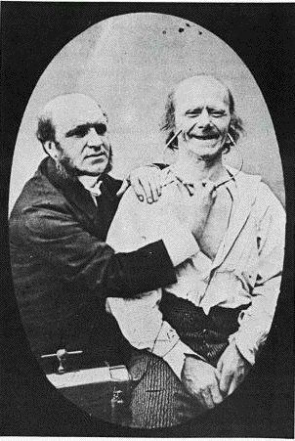
Stoic and Emotional Perspectives in Decision Making
Measuring emotions
Each basic emotion has a unique facial expression
Duchenne, 1862

Slide 14

Stoic and Emotional Perspectives in Decision Making
Measuring emotions
Each basic emotion has a unique facial expression
Happiness

Slide 15

Stoic and Emotional Perspectives in Decision Making
Measuring emotions
Each basic emotion has a unique facial expression
Surprise

Slide 16
Stoic and Emotional Perspectives in Decision Making
Measuring emotions
Each basic emotion has a unique facial expression
Anger

Slide 17

Stoic and Emotional Perspectives in Decision Making
Measuring emotions
Each basic emotion has a unique facial expression
Anger

Slide 18
Stoic and Emotional Perspectives in Decision Making
Measuring emotions
Each basic emotion has a unique facial expression
Contempt

Slide 19

Stoic and Emotional Perspectives in Decision Making
Measuring emotions
Each basic emotion has a unique facial expression
Contempt

Slide 20
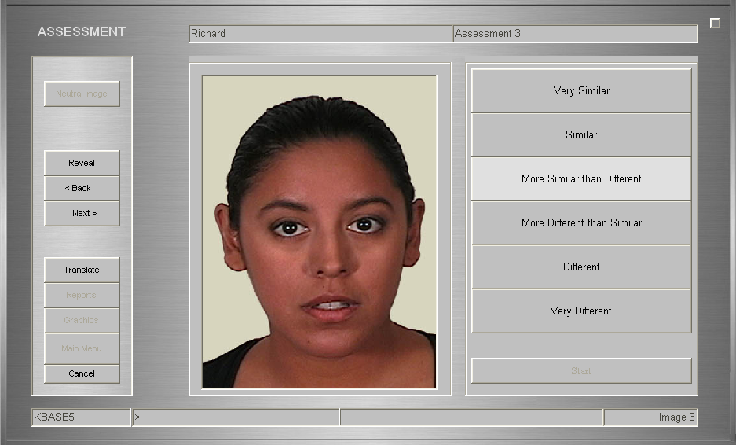
Stoic and Emotional Perspectives in Decision Making
Measuring emotions
Subject responds with level of concordance
Validated and used in doctoral dissertations

Slide 21
Stoic and Emotional Perspectives in Decision Making
Measuring emotions
How to compute an overall measure of EMOTIONAL QUALITY (EQ)
+100
SUM OF:
[Happiness, Interest, Surprise]/3
EQ = +35
0
SUM OF:
[Fear, anger, contempt, distress,
disgust, anxiety, shame, sadness]/8
-100

Slide 22
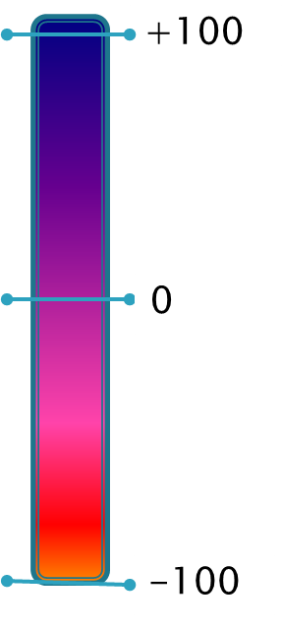

Stoic and Emotional Perspectives in Decision Making
Measuring emotions
Pretest Post-test
EQ = +35
EQ = -10
EQΔ = -45

Slide 23
Stoic and Emotional Perspectives in Decision Making
The experiments
Overview of the Research Design
Cognitive Assessment
Emotional Assessment
Analysis of cut, carat, clarity, and color
Baseline
Blood Diamond
Post-Test
Baseline
Certified
Post-Test

Slide 24
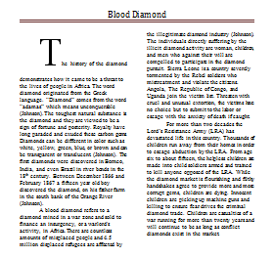

Stoic and Emotional Perspectives in Decision Making
The experiments: Treatment A “Blood Diamond”
“Blood Diamond”
Diamond is a “Blood Diamond”

Slide 25

Stoic and Emotional Perspectives in Decision Making
The experiments: Treatment B “Certified Diamond”
“Blood Diamond”
Diamond has a Kimberly Process Certificate

Slide 26
Stoic and Emotional Perspectives in Decision Making
Hypotheses
Ha_{1:} BLOOD DIAMOND WILL CAUSE DECLINE IN EQ
The Emotional Quality (EQ) score for Treatment A will decline from a baseline score. (Ho=0/Ha<0).
Ha_{2:} CERTIFICATE WILL CAUSE INCREASE IN EQ
The Emotional Quality score for Treatment B will increase from a baseline score (Ho=0/Ha>0).

Slide 27
Stoic and Emotional Perspectives in Decision Making
Hypotheses
Ha₃ BLOOD DIAMOND WILL CAUSE GREATER CHANGE THAN
CERTIFIED
The Absolute Value Change (AVC) in the Emotional Quality score for Treatment A will be greater than the AVC for Treatment B (AC_{EQA}>AC_{EQB}).
Ha_{4:} SUBJECTS WILL BE DIFFERENT
The influence of emotions on the cognitive assessments will differ by subject for both Treatment A and Treatment B (EQ_{n}<>EQ_{n+1}<>EQ_{n+2}<>EQ…).

Slide 28
Stoic and Emotional Perspectives in Decision Making
Results
Ha_{1:} BLOOD DIAMOND WILL CAUSE DECLINE IN EQ
NOT SIGNIFICANT, p=.17
Ha_{2:} CERTIFICATE WILL CAUSE INCREASE IN EQ
NOT SIGNIFICANT, p=.46
Ha₃ BLOOD DIAMOND WILL CAUSE GREATER CHANGE THAN CERTIFIED DIAMOND
SIGNIFICANT, p=.03
Ha_{4:} SUBJECTS WILL BE DIFFERENT
SIGNIFICANT, p=.00

Slide 29
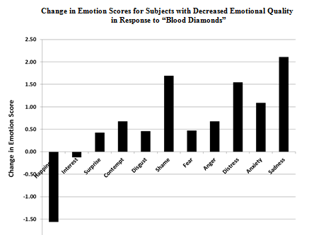
Stoic and Emotional Perspectives in Decision Making
Results/ Emotional Responses to Blood Diamonds

Slide 30
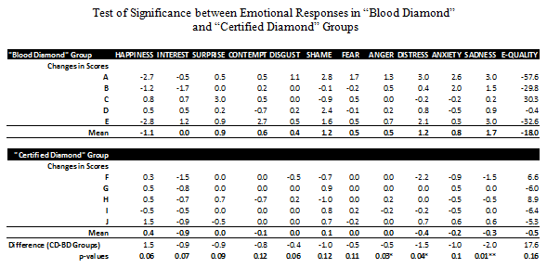
Stoic and Emotional Perspectives in Decision Making
Results/ Emotional Differences Between Groups
Anger
Distress
Sadness

Slide 31
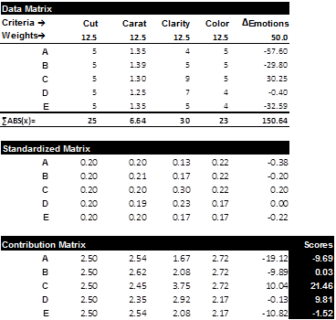
Stoic and Emotional Perspectives in Decision Making
Matrix
Cognitive components
Emotional responses
Weighted preference scores

Slide 32
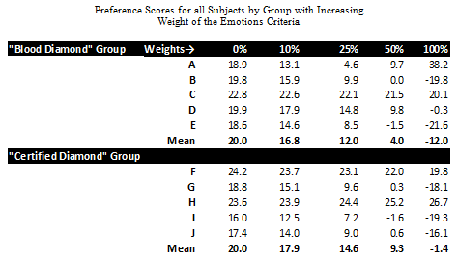
Stoic and Emotional Perspectives in Decision Making
Results/ Payoff Matrix Results
Emotion Weight= 0
Emotion Weight= 100

Slide 33
Stoic and Emotional Perspectives in Decision Making
Results/ Preference Curves for “Blood Diamonds”
Preference Score
Increasing Weight of Emotions →

Slide 34
Stoic and Emotional Perspectives in Decision Making
Results/ Preference Curves for “Certified Diamonds”
Preference Score
Increasing Weight of Emotions →

Slide 35
Stoic and Emotional Perspectives in Decision Making
Discussion
Emotional responses provide some type of information, proof of that is provided by the fact that preferences change when one includes emotional influences to greater or lesser degrees.
One can argue that it is better to include more information rather than less when making a decision;
Perhaps the question is not whether emotions should play a part in decision-making but rather how the information in emotions should be included.

Slide 36
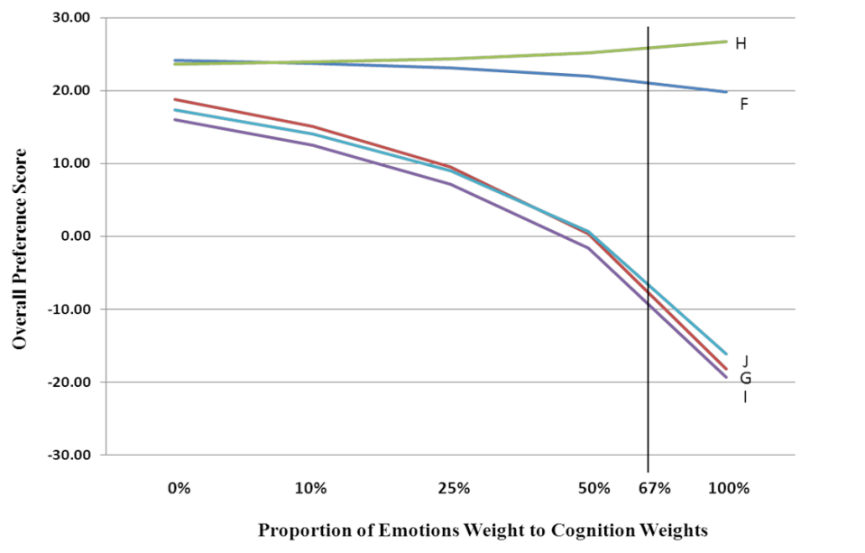
Stoic and Emotional Perspectives in Decision Making
Discussion
The Preference Curves suggest it may be possible to classify individuals into “Emographic” categories based upon their emotional responses.
There are implications here about team decision-making, negotiation, brand management, other…
Discussion…

